Slide 1
Event Management Website
By:Shagun Jindal
By:Soumya Jain

Slide 2
INTRODUCTION
The objective of this application is to develop a system that effectively manages all the data related to the various events that take place in an organization. The purpose is to maintain a centralized database of all event related information. The goal is to support various functions and processes necessary to manage the data efficiently.
This existing system is not providing secure registration and profile management of all the users properly. This system is not providing on-line Help. This system doesn’t provide tracking of users activities and their progress. This manual system gives us very less security for saving data and some data may be lost due to mismanagement. This system is not providing event management through internet. This system is not providing proper events information. The system is giving manual information through the event management executer

Slide 3
PROPOSED SYSTEM
The development of this new system contains the following activities, which try to automate the entire process keeping in the view of database integration approach. This system maintains user’s personal, a and contact details. This system will provide on line help and search capabilities. User friendliness is provided in the application with various controls provided by system rich user interface. Authentication is provided for this application only registered users can access. event information files can be stored in centralized database which can be maintained by the system. This system provides the users to manage the events systematically.

Slide 4
EVENT MANAGEMENT SYTEM MODULE
Admin Module
Dashboard: In this section, admin can see all detail in brief like listed categories, Sponsors, Total Events, Total Registered Users, Total Booking, Total New Booking, Total Confirmed Booking and Total Cancelled Booking.
Category: In this section, admin manage event category (add and update).
Manage Sponsors: In this section, admin can add sponsors and manage sponsors details (Add/Update/Delete).
Events: In this section, admin manage events (add and update).
Manage Users: In this section, admin can update details of registered users and also block them.
Manage Booking: In this section, admin can manage booking by cancel and confirm it.
News: In this section admin manage news (add and delete).
Website Setting: In this section, admin can update about us and another general website setting.

Slide 5
2. USER MODULE
In this module there is two types of user guest user and registered user.
Guest User: In this guest user can see only general information like about us, event details,
contact details and new about events.
Registered users can do following activity
1.Books the events.
2.Update his/her own profile.
3.Change Password.
4.Users can also cancel booking which is not confirmed.
5.Registered user can also recover his/her own password

Slide 6
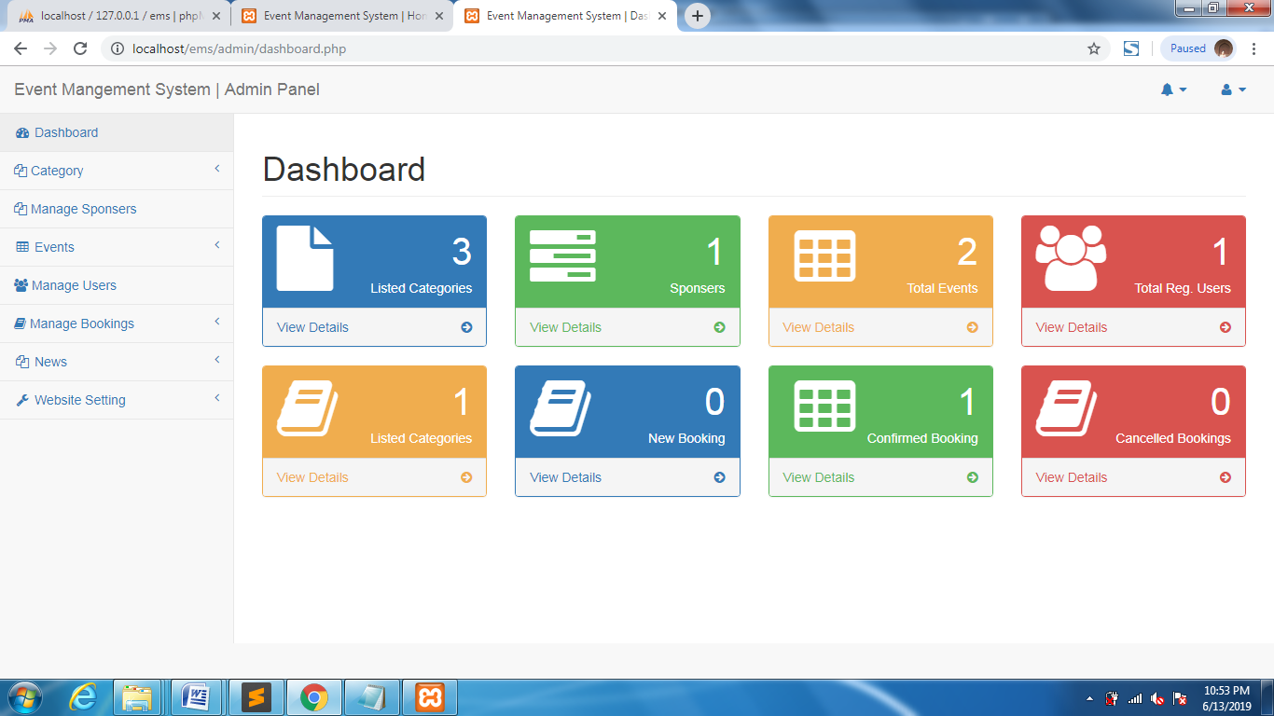
ADMIN SCREENSHOT

Slide 7
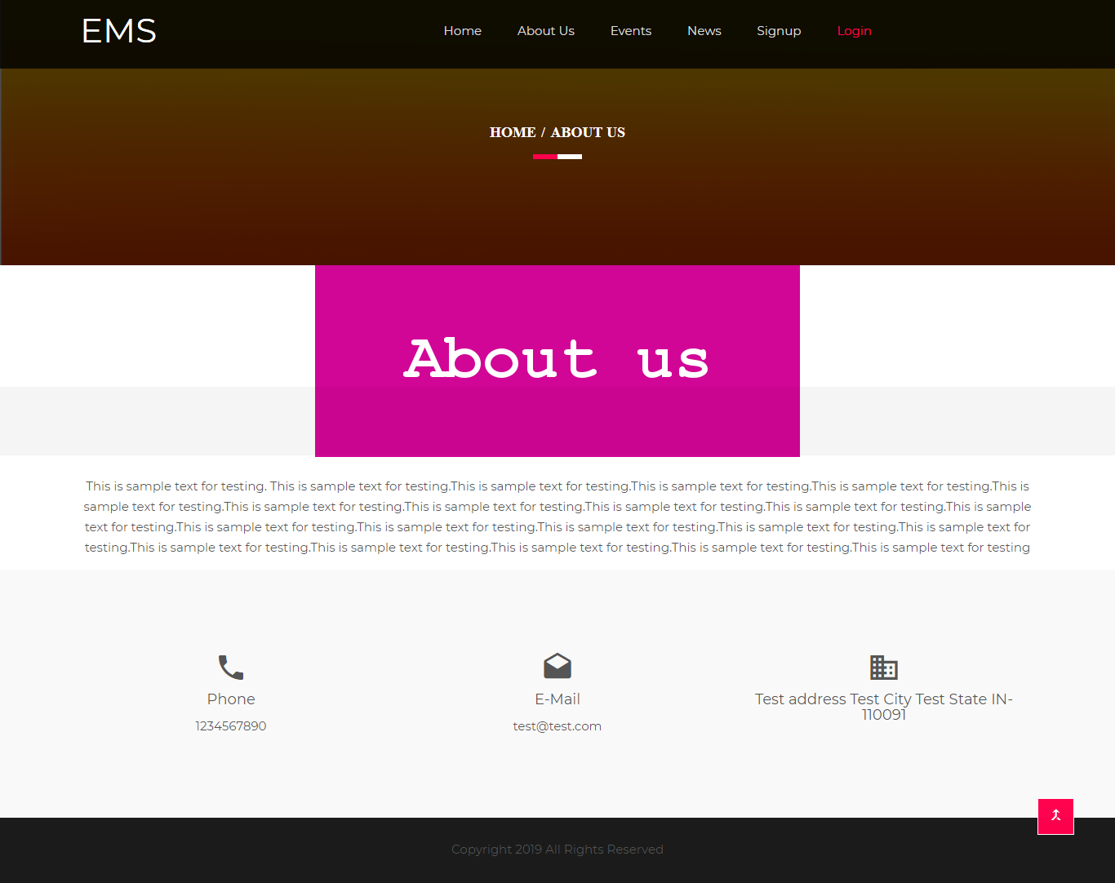

Slide 8
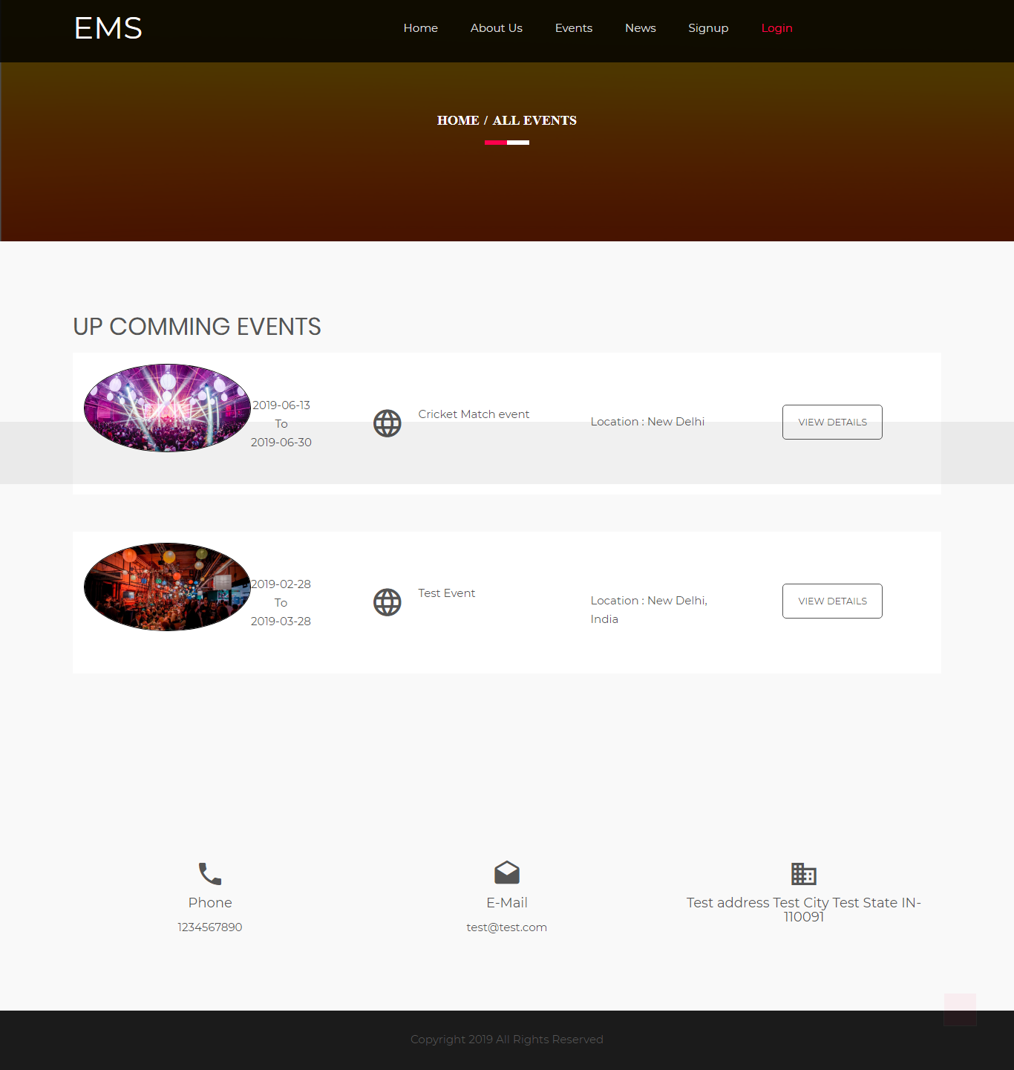

Slide 9
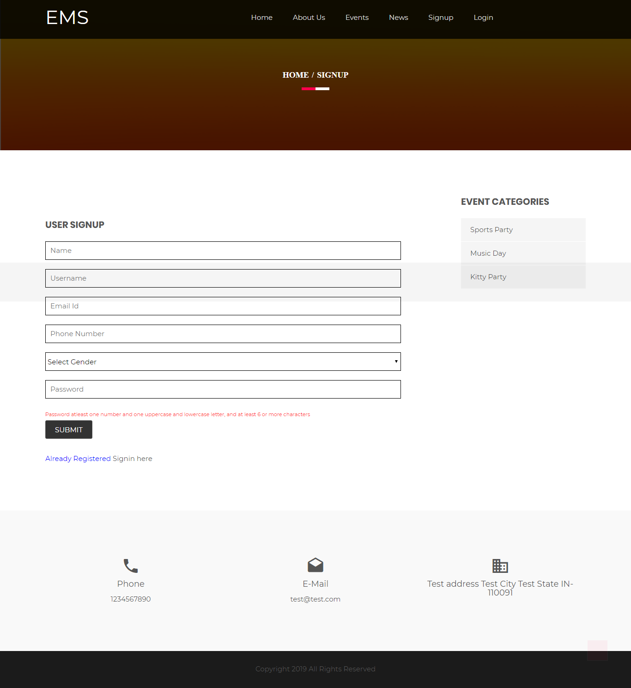

Slide 10
CONCLUSION
The “Event Management System” was successfully designed and is tested for accuracy and quality.During this project we have accomplished all the objectives and this project
meets the needs of the organization. The developed will be used in searching, retrieving
and generating information for the concerned requests.
GOALS ACHIVIED
Reduced entry work
Easy retrieval of information
Reduced errors due to human intervention
User friendly screens to enter the data
Portable and flexible for further enhancement
Web enabled.
Fast finding of information request

Slide 11
THANK YOU

